Slide 1







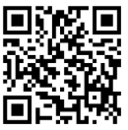
The Integrated Industrial Partnership
for Sustainable Economic Development
Private Sector Workshop
Thursday, March 20th, 2025
Attendance Registration and Feedback

Slide 2
Agenda
Item
Time (UAE)
Time (Qatar)
Welcome, Objectives and Agenda
Overview of the industrial partnership
Overview of Qatar Industrial Landscape
Overview of Türkiye Industrial Landscape
Companies Introduction and preliminary discussion
  Pharmaceuticals
  Agriculture, Food and Fertilizers
  Chemicals, Plastics And Downstream Products
  Metals, Minerals And Downstream Products
  Textiles
13:00 – 13:05
13:05 – 13:15
13:15 – 13:25
14:25 – 14:35
14:35 – 15:00
12:00 – 12:05
12:05 – 12:15
12:15 – 12:25
12:25 – 12:35
12:35 – 14:00
Attendance Registration and Feedback

Slide 3
Workshop objectives
Introducing the work team
Introducing the participating private sector companies
Giving an overview of the sustainable industrial partnership and its objectives
Giving an overview of the advantages and incentives for investment in Qatar and Türkiye
Collecting initial views from the private sector on opportunities for partnerships
Agreeing on next steps

Slide 4
Agenda
Item
Time (UAE)
Time (Qatar)
Welcome, Objectives and Agenda
Overview of the industrial partnership
Overview of Qatar Industrial Landscape
Overview of Türkiye Industrial Landscape
Companies Introduction and preliminary discussion
  Pharmaceuticals
  Agriculture, Food and Fertilizers
  Chemicals, Plastics And Downstream Products
  Metals, Minerals And Downstream Products
  Textiles
13:00 – 13:05
13:05 – 13:15
13:15 – 13:25
14:25 – 14:35
14:35 – 15:00
12:00 – 12:05
12:05 – 12:15
12:15 – 12:25
12:25 – 12:35
12:35 – 14:00
Attendance Registration and Feedback

Slide 5


The Industrial Partnership for Sustainable Economic Development
Countries
Pharmaceuticals
Textiles
Chemicals, plastics and downstream products
Metals, minerals and downstream products
Agriculture, food and fertilizers
Strategic Sectors
Supply chain security and resilience
Localization
& value-chain synergies
Integrated value-add manufacturing
Economic growth, diversification
& job creation
Sustainability-led growth
Strategic Objectives

Slide 6
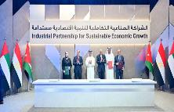
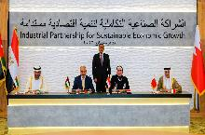
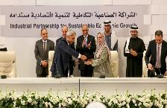
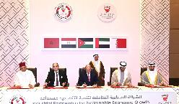
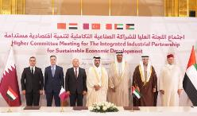
Three Years of Progress Through the Industrial Partnership for Sustainable Development
May 2022
July 2022
January 2023
January 2024
February 2025
Held in Abu Dhabi, UAE
Launch of the partnership between the UAE, Egypt, and Jordan
Governance system activation
Activation of the Executive Committee and sectoral & enablers teams
Held in Cairo, Egypt.
The Kingdom of Bahrain joined the partnership.
Workshops for more than 50 companies were conducted.
88 proposals for industrial projects were received.
Held in Amman, Jordan.
Announced 12 partnership agreements for industrial projects.
Workshops for over 100 companies were conducted.
35 new proposals for industrial projects were received.
Held in Bahrain.
The Kingdom of Morocco joined.
Announcement of 5 new projects and agreements in the sectors of metals and electric vehicles.
Held in Qatar.
The Republic of Turkey and State of Türkiye Join the partnership
Announcement of 12 new projects and agreements in the sectors of food, metals and electrical equipment worth USD 2 Billion
1st Higher Committee Meeting
2nd Higher Committee Meeting
3rd Higher Committee Meeting
4th Higher Committee Meeting
5th Higher Committee Meeting

Slide 7




The economic factors of the partnering countries combined.
2.5
260
7
USD Trillion
Million
GDP
Population
Partnership Countries
1
435
400
USD Trillion
USD Billion
USD Billion
Total Imports
Manufacturing Value Add
Industrial Exports

Slide 8
Joint investment opportunities
4
3
Food and agriculture
2
1
Pharmaceuticals
Metals
Chemicals
Generics
Biosimilars
Active Pharmaceutical Ingredients (APIs)
Medical Supplies
Ophthalmic Drugs
Vitamins and Dietary Supplements
Silica production for glass
Aluminum, copper, and iron products
Glass
Raw material supply for securing supply chains
Cereals, meat, dairy products, and canned food
Fertilizers
Nutritional supplements
Agricultural technology and sustainable farming methods
Soda ash
Basic chemicals (PP, PE, PU, etc.)
Packaging and plastic products
Construction sector chemicals
Electrical Equipment
4
Renewable and clean energy
7
6
5
Automotive
Textiles
Solar power units
Solar cells
Energy storage batteries
Inverter assembly and production of solar power system equipment and components
Vehicle components (seats, exhaust systems, air conditioning, electrical connections, tires, glass, batteries)
Structural aluminum parts
Electric vehicle assembly
Textile production
Polyester
Construction and building equipment
Agricultural equipment and machinery
Energy equipment and generators

Slide 9
The main partnership projects that have been announced.
Announced and ongoing projects.
Updates | Countries | Investment Size ($) | Project/ Agreement | #
The imported materials amounted to AED 1.1 billion from the date of signing the agreement until the end of 2024. |  | 2000 | Supply of iron ore pellets from "Bahrain Steel" to "Emirates Steel". | 1
Production Start 2028 |  | 500 | Establishment of a factory in Egypt to produce sodium carbonate by "Soda Chemicals Industries" (Egyptian company). | 2
Technology has been transferred, and products are being registered in Middle Eastern export countries |  | 60 | Pharmaceutical research and development and drug production in the UAE by "Global Pharma" (UAE) and "Safi Pharma" (Jordan). | 3
Announced and under-development projects.
Countries | Investment Size ($) | Project/ Agreement | #
 | - | Signing of an agreement to develop an industrial land in East Port Said with an area of 20 square kilometers. | 1
 | 400 | Establishment of a complex for producing feed additives and chemicals in Egypt by "CFC" (Egyptian company). | 4
 | 30 | Production of biological and chemical eye medications (UAE) by "Gulf Inject" (UAE) in collaboration with "Oman Pharmaceutical Industries" (Jordan). | 5

Slide 10
The value of the projects that will be announced in Qatar on February 9, 2025
USD 2 Billion
Countries | Value | Project/ Agreement | #
 | 95 | A supply agreement for fiberglass pipes between "Future Pipes" (UAE) and "Med Gulf" (Qatar). | 1
 | 50 | A cooperation memorandum between "Global Pharma" (UAE) and "Zenith Pharma" (Morocco) in the fields of injectable medicines, biosimilars, and cholesterol and diabetes drugs. | 2
 | 250 | The inclusion of the "Pharmaceuticals" factory in Egypt and "Fay" in Morocco into the portfolio of "Mubadala Investment Company" (UAE). | 3
 | 10 | A memorandum of understanding between "ISC Capital" (UAE) and "Al-Jazeera Farms" (Bahrain) to establish a factory for producing microalgae-based dietary supplements in Bahrain. | 4
 | 7 | The announcement of a new factory for cable connectors and accessories in the UAE in collaboration with "Giza Cables" (Egypt). | 5
 | 10 | A supply agreement for plastic containers from "Oxid Electronics" (Jordan) to "National Dairy (Hayatna)" (UAE). | 6
 | 10 | A supply agreement for plastic bottle caps from "Delta Nile" (Egypt) to "National Dairy (Hayatna)" (UAE). | 7
 | 15 | A supply agreement for animal feed from "National Feed" (UAE) to "Al-Rayyan Equestrian Supplies" (Qatar). | 8
 | 20 | A memorandum of understanding to supply glass for mirror and silvered glass production from "Emirates Glass" (UAE) to "Al Madina Glass" (Bahrain). | 9
 | 60 | A strategic memorandum of understanding between "Dolidol" (Morocco) and "Intercoil" (UAE) to invest in new sponge production lines in the UAE. | 10
 | 1266 | A raw materials supply agreement between Bahrain Steel and Qatar Steel for a quantity of 5 million metric tons over a period of five years | 11
 | 220 | Establishment of a factory in Egypt with “JA Solar" (Chinese company) for manufacturing solar cells and solar modules | 12

Slide 11
Steps to submit a project within the industrial partnership
Complete the industrial project proposal form and submit to the ministry's working team in the concerned country.
Initial assessment of the project , based on alignment with the strategic objectives, feasibility, readiness level, and anticipated impact.
Approval for the project from the Executive Committee.
Announce the project during the higher Committee meeting.
Ongoing monitoring and support of the project

Slide 12
Sector
Company
Country
Contact name
Title
Contact details
Email, Phone
Project
Summarized project name
Project description and details
Description (details about the project, green field or expansion) e.g. setting up a facility to manufacture xxx in yyy
Capacity
Estimated investment amount
Country roles what is the specific role of any of the countries in the partnership
Products to be manufactured
Preliminary market and demand data if available
Extra slides can be used to fit more details

Slide 13
Incentives and enablers
Detail the required enablers and incentives and in which country
Examples:
1- require investment of [] USD M
2- require loan of [] USD M
3- Require offtakes/ commercial partnerships
4- technology partnerships
5- other requests for enablers for the project to succeed
Partner companies
Company | Country | Role
 |  | Investor, partner, raw material supply, offtaker, tech transfer , etc..
Project status
What is the current status of the project (idea stage, some preliminary feasibility, detailed feasibility, etc.)
Latest updates
Was this project discussed with the other companies involved?

Slide 14
Agenda
Item
Time (UAE)
Time (Qatar)
Welcome, Objectives and Agenda
Overview of the industrial partnership
Overview of Qatar Industrial Landscape
Overview of Türkiye Industrial Landscape
Companies Introduction and preliminary discussion
  Pharmaceuticals
  Agriculture, Food and Fertilizers
  Chemicals, Plastics And Downstream Products
  Metals, Minerals And Downstream Products
  Textiles
13:00 – 13:05
13:05 – 13:15
13:15 – 13:25
14:25 – 14:35
14:35 – 15:00
12:00 – 12:05
12:05 – 12:15
12:15 – 12:25
12:25 – 12:35
12:35 – 14:00
Attendance Registration and Feedback

Slide 15

Overview of the Industrial Sector, Incentives and Investment Opportunities in Qatar

Slide 16
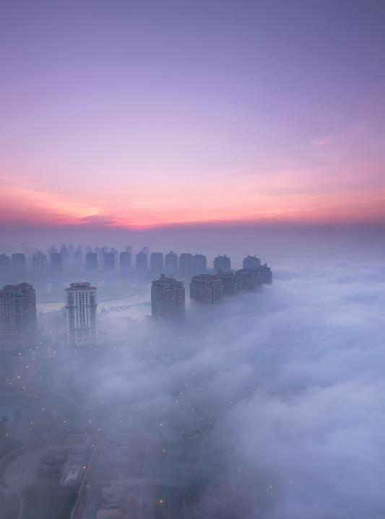
Table of Contents
1
The Competitive Advantages of the State of Qatar
2
The Key Imports of the State of Qatar
3
The Key Exports of the State of Qatar

Slide 17
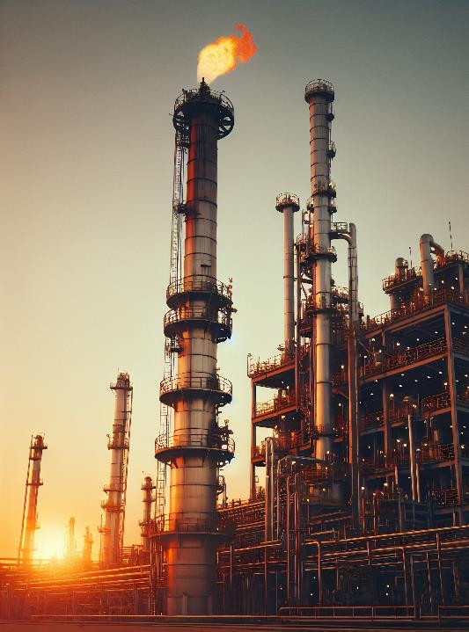
Summary of the Objectives and Expected Benefits
of the State’s Participation in the Partnership
Evaluation of Qatar's Industrial Competitive Advantages and Their Contribution to Achieving Partnership Goals:
Petrochemicals and Fertilizers: Qatar's petrochemical and fertilizer sectors enable participation in value-added partnerships, offering essential products for agriculture and various industries worldwide. These sectors can attract foreign investment, facilitate technology exchange, and open new markets, thereby strengthening Qatar’s global trade relationships.
Iron and Steel: The iron and steel sector can drive economic partnerships by providing high-quality materials for global construction projects. Collaborating with international companies on infrastructure projects enhances knowledge exchange and technological advancements in sustainable construction practices
Market Expansion
Access to Shared Resources
Strengthening Ties Between participating Countries

Slide 18
















Overview of Qatar’s Economy and Industrial Sector
Agriculture, Food, and Fertilizers
Qatar’s GDP (2023)
$213 billion USD
Industrial sector's contribution to GDP(2023)
$128 billion USD (60%)
Pharmaceuticals
Total Exports (2023)
$97 billion USD
Chemicals, Plastics, and Processed Products
Industrial Exports (2023)
$36 billion USD
Metals and Processed Products
Total Imports (2023)
$31 billion USD
Population
3.19 million

Slide 19







Competitive Advantages of the State of Qatar
Global Trade Agreements
Prime Strategic Location: Second Largest Air Cargo Fleet
A Leader in Fertilizer Production
A Leader in Steel Production in the Middle East
An Integrated Hub for Petrochemicals
QAFCO is the world's largest producer of nitrogen-based fertilizers.
World-Class Telecommunications and Infrastructure
Incentives for Manufacturers
Incentives for Trading Companies

Slide 20




Incentives Offered to Qatari and Non-Qatari Investors in the Industrial sector
Financial support
Incentives and Facilitations
Cost Reduction
Loan Facilities Through Local Banks
Financial Incentives for Research and Development Projects
Opportunity for Equity Participation
Market
Land
100% Ownership for Foreign Investors in the Industrial Sector
10% Price Preference in Public Tenders for Local Products
Freedom for Non-Qatari Investors to Make All Investment Transfers Inside and Outside the Country
Land Allocation with a Nominal Rent of 10 Qatari Riyals per Square Meter Annually
Essential Facilities and Services
Low Electricity Price 0.13 Qatari Riyals per kWh
Low Water Price 5.4 Qatari Riyals per cubic meter
Reduced Gas Costs
Taxes
Exemption from Customs Duties on Project Imports of Raw Materials and Machinery
Exemption from Income Taxes

Slide 21
The Key Imports of the State of Qatar

Slide 22
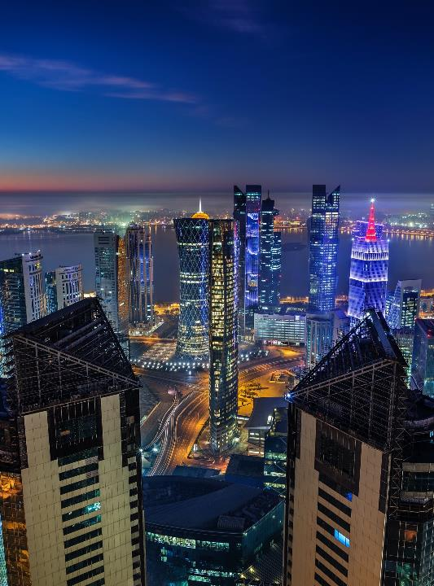
Partnership Information
The Industrial Integration Partnership for Sustainable Economic Development comes within the framework of the fraternal relations between the countries (the United Arab Emirates, the Hashemite Kingdom of Jordan, the Arab Republic of Egypt, the Kingdom of Morocco, the Kingdom of Bahrain, and the Republic of Turkey). Its goal is to strengthen these relations by exploring partnership and investment opportunities, aiming to deepen coordination, cooperation, and strategic integration among them, in accordance with the prevailing laws in each of the participating countries, to serve the interests of their peoples.
A list of industrial imports has been extracted and categorized as follows:
Most Imported Industrial Products
Qatari Factories with the Highest Imports
Most Imported Products from the factories
*We can further detail the study based on the requirements of the partnership members.
Study of Integration Opportunities

Slide 23
Key Industrial Products Imported into the State of Qatar (2022-2024)
The Key Industrial Imports Consist of 5 Main Categories:
Metals
Mechanical appliances
Chemicals and allied products
Mineral products
Plastic articles
10,684,537,325
Qatari Rials
9,749,186,748
Qatari Rials
5,780,542,828
Qatari Rials
3,306,082,372
Qatari Rials
1,866,281,052
Qatari Rials
More information can be found in appendix 1

Slide 24
The Key Exports of the State of Qatar

Slide 25
The main exports of the State of Qatar

Slide 26
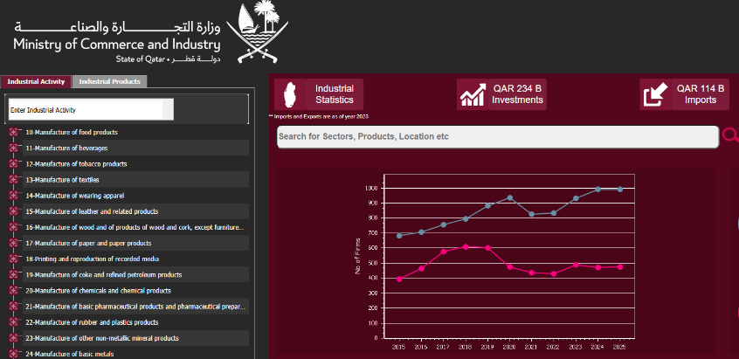
Qatar Industrial Portal idb.moci.gov.qa
The Qatar Industrial Portal is a digital hub aimed at providing accurate and up-to-date data about the industrial sector in Qatar, making it easier to access information related to local factories and industrial products.
The portal aims to enhance investments in the industrial sector by providing information and statistics that help investors make informed decisions.

Slide 27
Agenda
Item
Time (UAE)
Time (Qatar)
Welcome, Objectives and Agenda
Overview of the industrial partnership
Overview of Qatar Industrial Landscape
Overview of Türkiye Industrial Landscape
Companies Introduction and preliminary discussion
  Pharmaceuticals
  Agriculture, Food and Fertilizers
  Chemicals, Plastics And Downstream Products
  Metals, Minerals And Downstream Products
  Textiles
13:00 – 13:05
13:05 – 13:15
13:15 – 13:25
14:25 – 14:35
14:35 – 15:00
12:00 – 12:05
12:05 – 12:15
12:15 – 12:25
12:25 – 12:35
12:35 – 14:00
Attendance Registration and Feedback

Slide 28
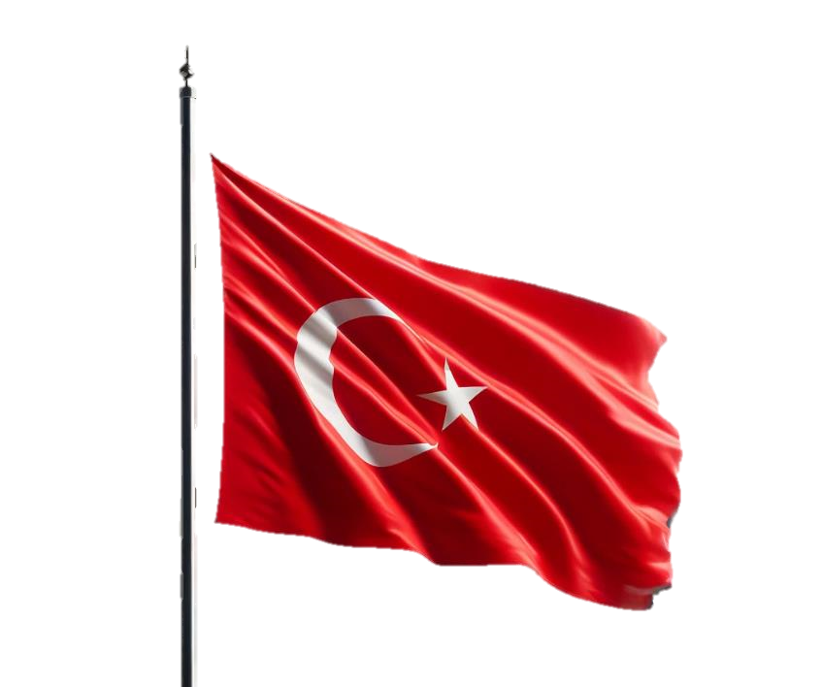
Overview of the Industrial Sector, Incentives and Investment Opportunities in Türkiye

Slide 29
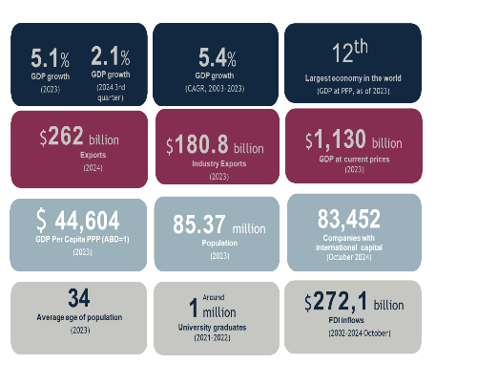
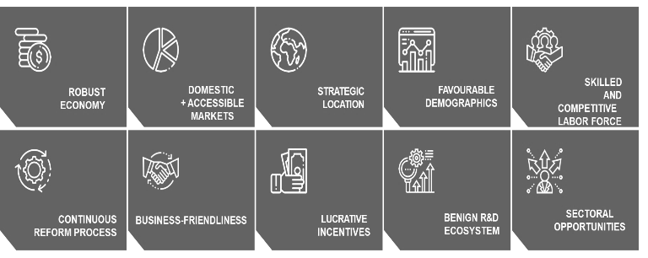
REASONS TO BECOME A PARTNER WITH TÜRKİYE
ROBUST ECONOMY

Slide 30

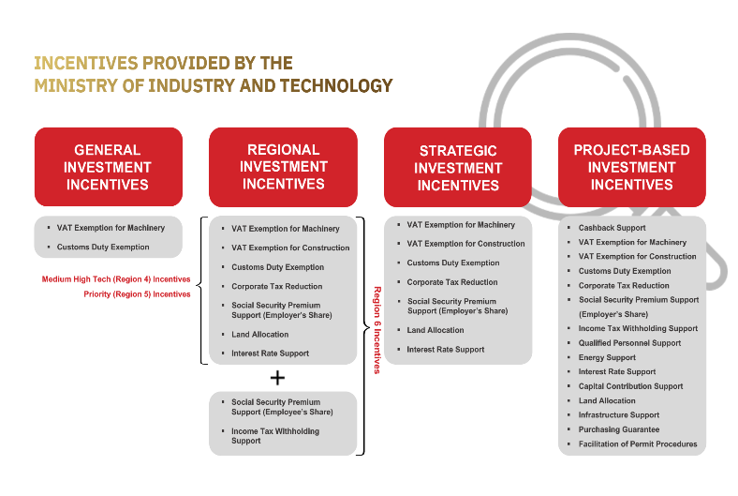

INVESTMENT INCENTIVES ECOSYSTEM
EQUAL TREATMENT OF INTERNATIONAL AND LOCAL INVESTORS
TAILORED AND COMPLETE PACKAGES FOR BOTH GREENFIELD AND BROWNFIELD PROJECTS IN MANUFACTURING, SERVICES, AND R&D

Slide 31









Mobility
Healthy Living
Communication
and Space
Advanced
Manufacturing
Digital Technologies
Semiconductors
Green Energy
Complementary Investments
n the Value Chain
$30
Billion
support budget
It is envisaged that a total of 30 billion dollars in support will be provided for high technology investments to be implemented by the year 2030
%70 Tax Exemption
%10 Employment Support
%10 Tax Return
%10 Grant Support
Program Characteristics
High incentive intensity
Fixed support package
Focused investment areas
Relatively smaller project scale
Characteristics of the System
High incentive intensity
Flexible support structure
Grant support elements

Slide 32
POTENTIAL COOPERATION OPPORTUNITIES AND PROJECT AREAS
Fertilizers
Source raw materials from Partnership member countries, including nitrogen, phosphorus, and sulfur
Pharmaceuticals
Increase mutual production
Experience of Turkish pharmaceutical companies on R&D
Strengthen regional value chain
Drought Resistant Plant Varieties
Favorable possibility for breeders and producers who are keen on investing in Türkiye
A burgeoning market for seed breeders
Food and Beverage
Joint processing and Logistic services for meat, vegetables and fruits, milled grain, vegetable products, bakery products, cocoa, chocolate, confectionery, pasta, vermicelli, couscous, bakery products
Petrochemicals
Supply raw materials from Partnership countries and supply intermediate goods or final products from Türkiye
Cooperate on sustainability and green economy
Mutually support environmentally friendly petrochemical projects
Vertical Farming
Mutually benefit hydroponic production
Adopt novel crop production techniques to decrease the consumption of resources like water, chemical fertilizers, and pesticides
Steel, Aluminum and Copper
Increase mutual trade
Mutual production of primary aluminum and sponge iron
Chips
Mutually producing chips
Foster cooperation to avoid semiconductor shortages
Strengthen regional value chain
Modern Irrigation Systems
Türkiye as a budding market for international irrigation system producers in the near future

Slide 33
Agenda
Item
Time (UAE)
Time (Qatar)
Welcome, Objectives and Agenda
Overview of the industrial partnership
Overview of Qatar Industrial Landscape
Overview of Türkiye Industrial Landscape
Companies Introduction and preliminary discussion
  Pharmaceuticals
  Agriculture, Food and Fertilizers
  Chemicals, Plastics And Downstream Products
  Metals, Minerals And Downstream Products
  Textiles
13:00 – 13:05
13:05 – 13:15
13:15 – 13:25
14:25 – 14:35
14:35 – 15:00
12:00 – 12:05
12:05 – 12:15
12:15 – 12:25
12:25 – 12:35
12:35 – 14:00
Attendance Registration and Feedback

Slide 34
Introduction to the participating companies and initial discussion of
cooperation opportunities
Company introduction
Initial views on industrial partnership opportunities between Türkiye and the partnership countries
Please scan here to register attendance and provide feedback on partnership opportunities:

